Slide 1
Solidity

Slide 2
Introduction to Solidity
What is Solidity?
Solidity is a high-level, statically typed programming language designed for writing smart contracts on the Ethereum blockchain.
It is influenced by languages like JavaScript, Python, and C++.
Solidity code is compiled into bytecode that runs on the Ethereum Virtual Machine (EVM).
Why Learn Solidity?
Enables the creation of decentralized applications (dApps).
Facilitates the development of smart contracts for various use cases like DeFi, NFTs, and DAOs.

Slide 3
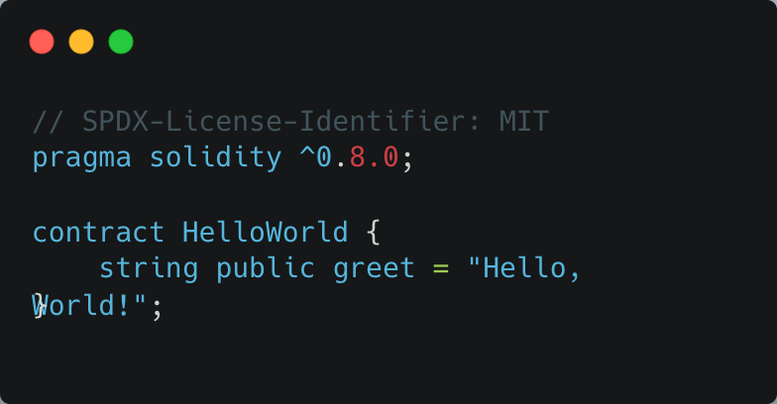
Structure of a Solidity Contract
pragma solidity ^0.8.0;: Specifies the compiler version.
contract HelloWorld: Defines a new contract named HelloWorld.
string public greet: Declares a public state variable greet.

Slide 4
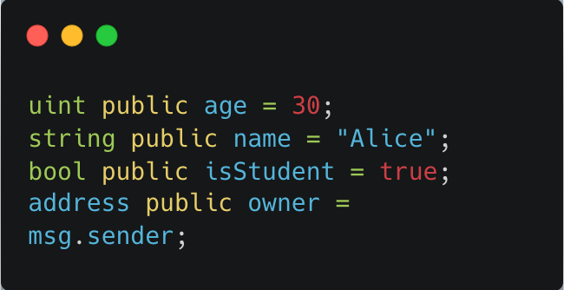
Variables in Solidity
Types of Variables:
State Variables: Stored on the blockchain.
Local Variables: Temporary, used within functions.
Common Data Types:
uint: Unsigned integer.
string: Text data.
bool: Boolean (true/false).
address: Ethereum address.
Each line declares a state variable with an initial value.

Slide 5
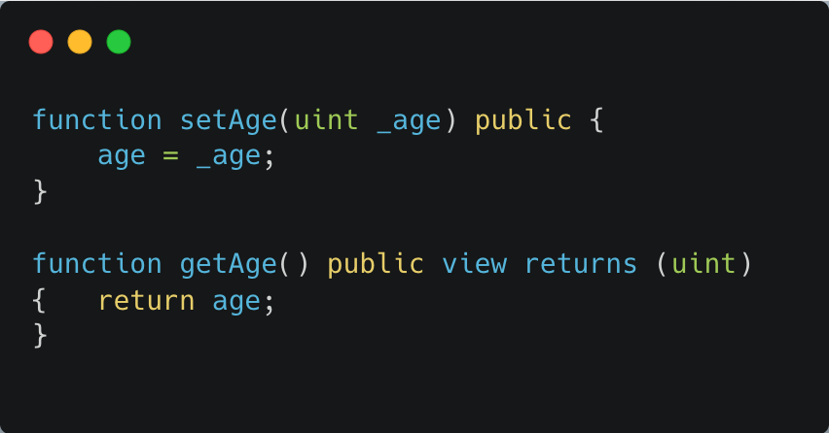
Functions in Solidity
setAge: Sets the age variable.
getAge: Retrieves the current value of age.

Slide 6
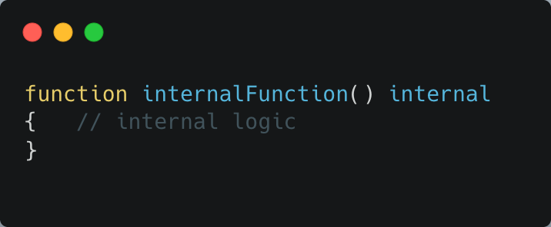
Access Modifiers
Purpose: Control who can call functions or access variables.
Common Modifiers:
public: Accessible by anyone.
private: Accessible only within the contract.
internal: Accessible within the contract and derived contracts.
external: Accessible only from outside the contract.
internalFunction can be called within the contract or by contracts that inherit from it.

Slide 7
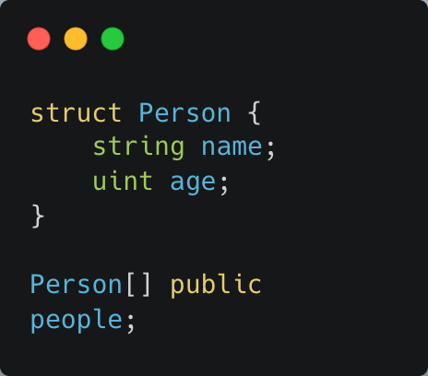
Arrays & Structs
struct lets you group data (like a form).
Person[] creates a dynamic array of people.

Slide 8
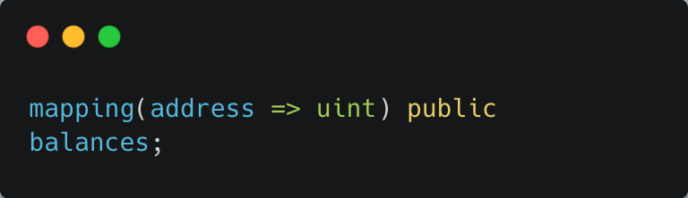
Mappings
Purpose: Store key-value pairs, like a phonebook.

Slide 9
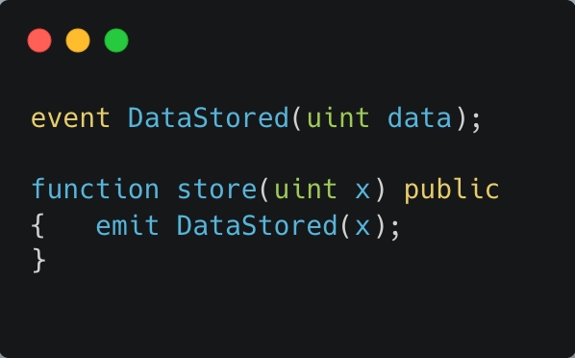
Events & Logging
Purpose: Let contracts communicate with external apps (like a frontend).

Slide 10
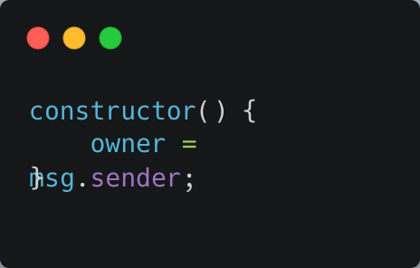
Constructor Functions
Purpose: Runs once when the contract is deployed.
Like setting up a username when you create an account.

Slide 11
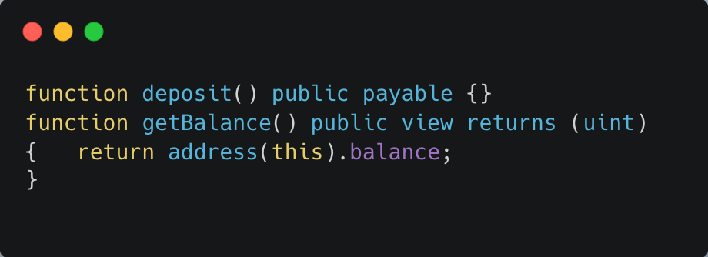
Ether & Payable Functions
Allow the contract to receive Ether.

Slide 12
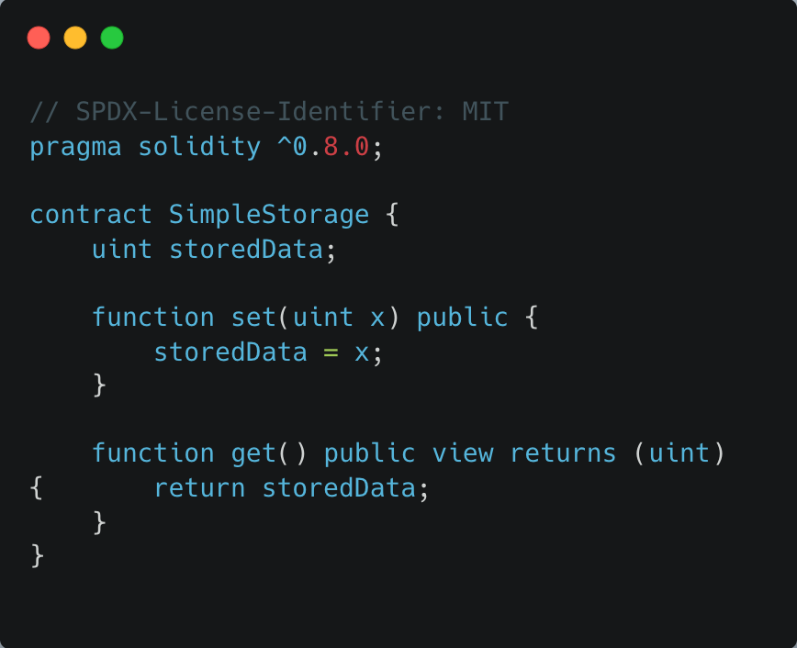
Writing Your First Smart Contract
Simple Storage Contract
set: Stores a value in storedData.
get: Retrieves the value of storedData.

Slide 13
How Smart Contracts Work
Analogy: Smart contracts are like vending machines: you insert coins (Ether), select a product (function), and the machine delivers it automatically.
Key Concepts:
Immutable: Once deployed, code cannot be changed.
Transparent: Code is visible and verifiable by anyone.
Trustless: No need to trust a third party; the code enforces rules.

Slide 14
Tools for Developing Solidity Contracts
Remix IDE: Web-based Solidity compiler and debugger.
Truffle Suite: Development framework for Ethereum.
Ganache: Personal blockchain for testing.
MetaMask: Browser extension for managing Ethereum wallets.

